Slide 1
what is systems design?
preparation of the system’s specifications
with focus on the “how”
user interfaces
(usage, navigation…)
database
(file structures, inter-relationships…)
module function specification
(how it transforms input into output)
software platform
(operating system, programming language…)
software architecture
(modules and their interfaces)
hardware configuration
(workstations, servers, network…)

Slide 2
requirements
developed first
agreement between client and analyst
describes what the system will provide and any constraints
natural language and conceptual diagrams
specifications
precise/specific statement of requirements
agreement between client and developers
describes the “how” in non-technical terms
formal notation and more detailed diagrams
design

Slide 3
and when you complete the design?
you have:
  screen and report layouts
  user instructions
  specifications for programmers
  instructions for operations
  backup and restart/recovery instructions
  an audit trail
documented in:
  text, diagrams, charts…
software architecture
global structure of processing components and data structures
software design
transformation of specifications into data structures and algorithms

Slide 4
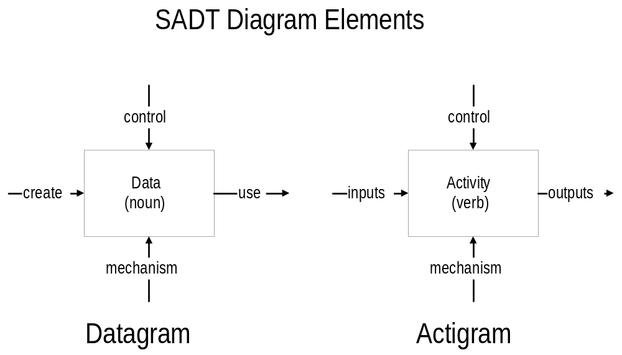
structured analysis and design techniques (SADT)
based on hierarchical decomposition of the system
simultaneous development of information and processing flows
© Dave Wortman, UofT

Slide 5
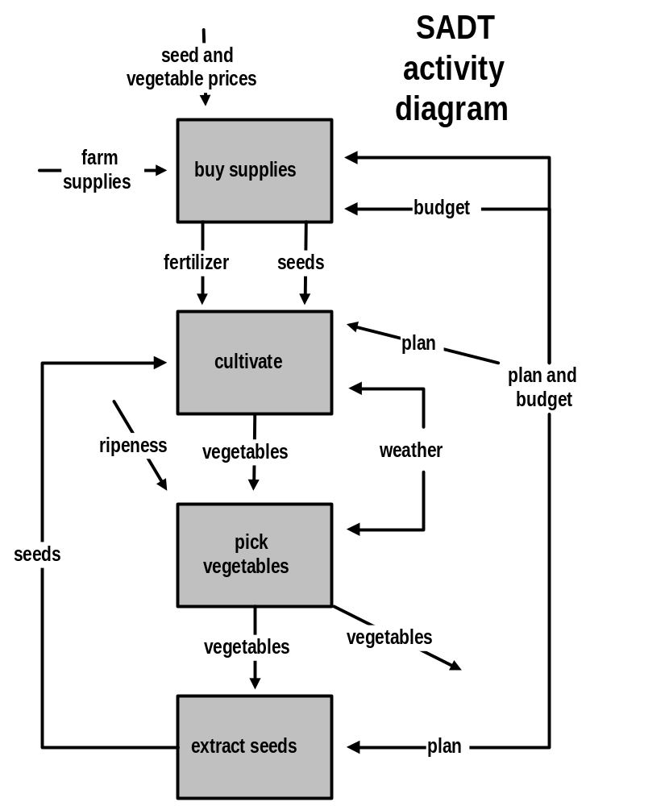
SADT activity diagram
© Dave Wortman, UofT

Slide 6
design options
modular decomposition
data-driven decomposition
event-driven decomposition
object-oriented design
hierarchical decomposition
prototyping
related
topics
abstraction
stepwise refinement
modularity
information hiding

Slide 7
software design issues / challenges
partitioning specifications
choosing data and software criteria for partitioning
representing information, processing steps, control flow…
separating function and data detail from abstractions
designing in testability, maintainability
achieving a complete, consistent, high-quality design

Slide 8
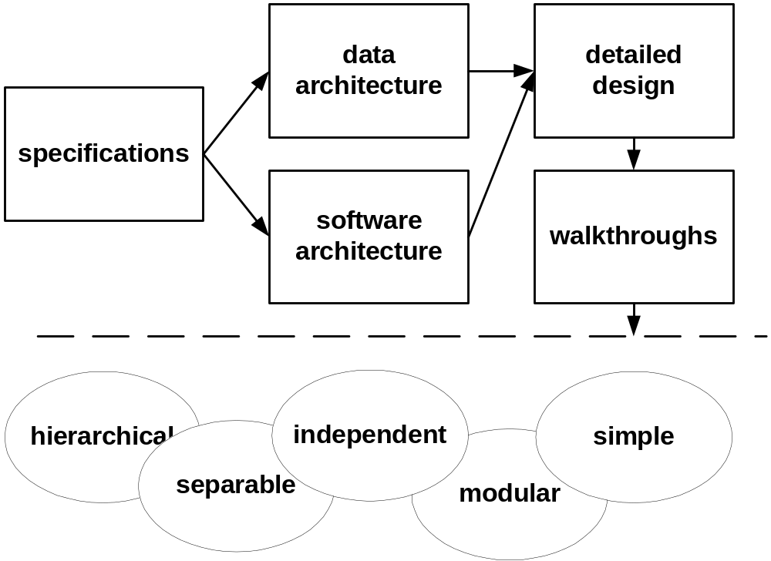
the design process
© Dave Wortman, UofT

Slide 9
what to design?
business procedures
user instructions
operating instructions
codes
data
processes
interfaces
controls
security
audit trails
backup/recovery
fault prevention
exception handling
test data
test methods/plans
in addition to documenting the design
  design rationale
  performance constraints

Slide 10
some advice
modularity
separate compilation
information hiding
functional independence:
  high cohesion
  low coupling
in order to…
reduce complexity
enhance understanding
simplify development
aid testing
ease maintenance burden
enhance portability
enhance auditability

Slide 11
functional independence
each module satisfies a small part of overall requirements
each module has a small interface
high cohesion (single-mindedness) and low coupling
good
levels of cohesion:
  functional
  sequential
  communicational
  procedural
  temporal
  logical
  coincidental
levels of coupling:
none
data
stamp
control
external
common
content
bad

Slide 12
Wasserman’s principles of data design
use systematic analysis of data
identify all data structures and the operations
performed on each
use a data dictionary to define data
design top-down, do bottom up last
represent data on a need-to-know basis
develop reusable libraries of common data structures
use abstract data types in design and implementation

Slide 13
procedural design
(what goes on inside each module)
structured English
flowcharts
decision tables
formulas
text…

Slide 14
meeting non-functional requirements?
after system design ...
  hardware, network, software platform are selected
  distribution of application and data is designed
so that ...
  data communication is minimized
  system can handle peak loads
  operation and maintenance costs are minimized
  security, reliability, availability are optimized
  reusability, portability are maximized

Slide 15
some choices you have
I/O modes: batch, online, remote batch . . .
I/O technologies to use: EDI, scanners, image interchange . . .
network: LAN, backbone, WAN, wide area network . . .
database management systems
software architectures
distribution of data and processing
other...

Slide 16
the users’ vantage point
At each location, the users can access the functions they need and the data they need without excessive cost nor any degradation of service with peak loads.
the system designer’s vantage point
The processing and the data are optimally located, the hardware is appropriate, expandable and the system is reliable and maintainable.

